Slide 1
Project Title: Employee Management System
Name: Swetha. S Date Submitted: 17.10.2024

Slide 2
Aim of the Project
To create a user-friendly application for managing employee records.
Enable adding, displaying, and storing employee details efficiently.
Improve data handling and accessibility in a business environment.

Slide 3
Business Problem or Problem Statement
Difficulty in tracking employee information and participation details.
Challenges in maintaining accurate and easily accessible employee records.
The need for a structured solution to manage employee data effectively.

Slide 4
Project Description
Overview: A system for managing employee records using JSON for data storage.
Scope: Adding new employees, displaying existing records, and error handling.
Technologies Used: Python, JSON for data storage.

Slide 5
Functionalities
Add Employee: Allows adding new employees with unique IDs.
Display Employees: Shows a list of all employees with their details.
Error Handling: Manages duplicate IDs and file access issues.
Load Employees: Reads employee data from a JSON file.
Save Employees: Writes updated employee data back to the JSON file.
User Interaction: Simple console interface for user commands.

Slide 6
Input Versatility with Error Handling
Handles various input types (ID, name, participation details).
Implements error handling for:
Duplicate employee IDs.
JSON decoding errors.
File access errors.
Example: Error messages for duplicate IDs and file issues.

Slide 7
Code Implementation
Key classes: Employee and EmployeeManager.
Data Structures: Employee instances stored in a list.
Code snippets demonstrating:
Employee creation.
JSON loading and saving.
Diagram illustrating the flow of data.

Slide 8
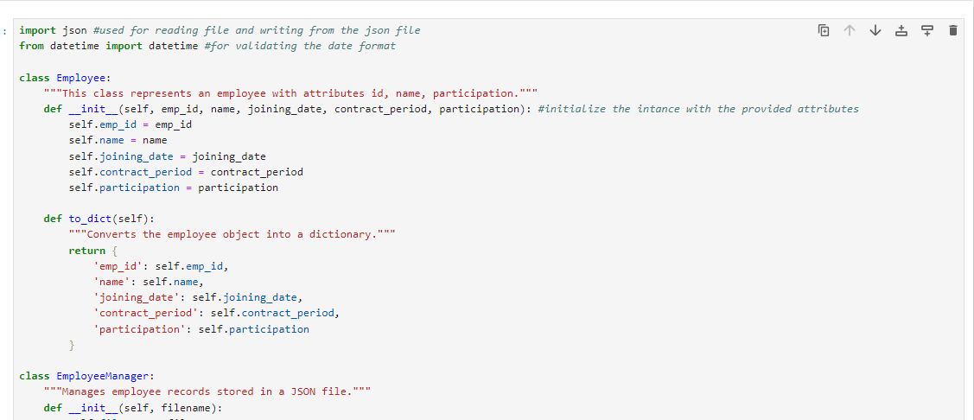

Slide 9
Results and Outcomes
Successfully manages employee data with no data loss.
Provides a clear overview of employee participation.
Visual representation of data (e.g., sample employee lists)

Slide 10
Conclusion
The Employee Management System effectively addresses the challenges of tracking and managing employee records within a business environment.
Key features include the ability to add and display employee details, ensuring unique identification through employee IDs, and implementing robust error handling to enhance user experience.
The use of JSON for data storage allows for easy retrieval and persistence of employee information, making it accessible and manageable.
Future enhancements could include functionalities such as editing and deleting employee records, as well as a graphical user interface to improve usability.
Overall, this project demonstrates a practical application of programming concepts and serves as a foundation for more advanced employee management solutions.

Slide 11
Thank you!

